Slide 1

Reac2Vac
Your Doctor’s Guide to Vaccine Adverse Reactions
Fabien Plisson
Insight Health Data Science

Slide 2
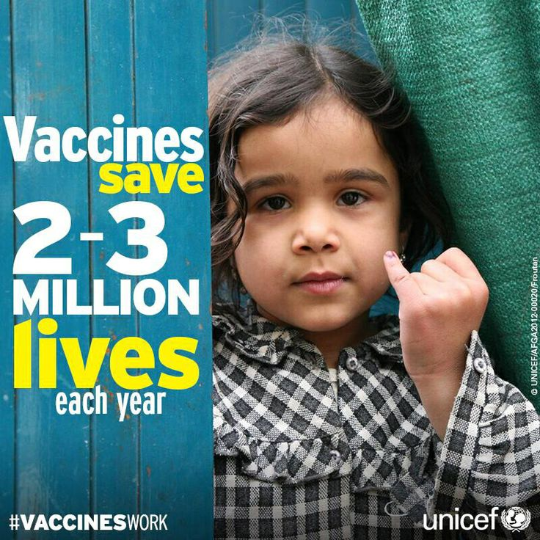

Slide 3
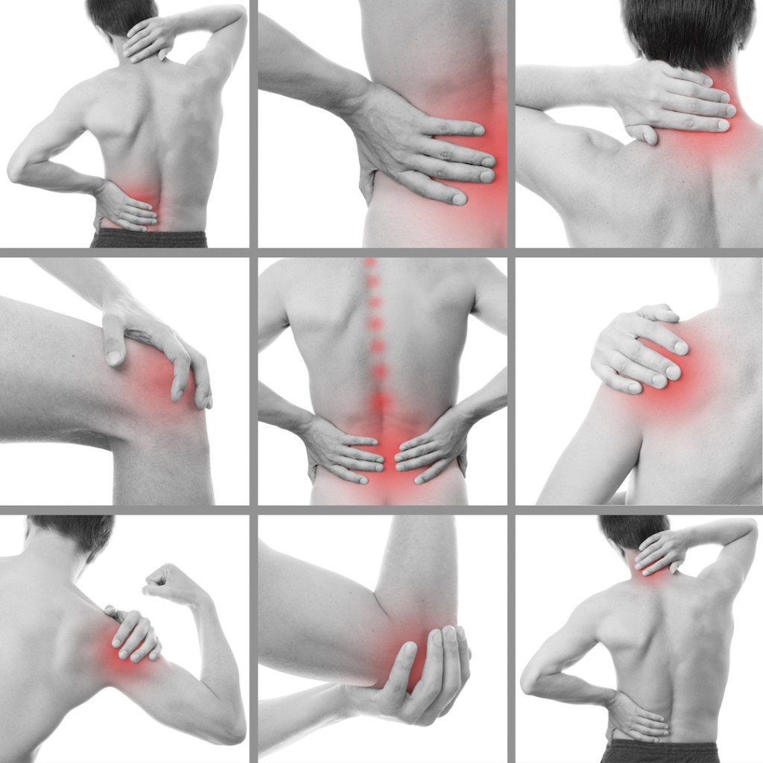
YET…
Problem Statement:
Can we predict the adverse events associated following immunization?
Target Audience:
Practitioners & Clinicians

Slide 4
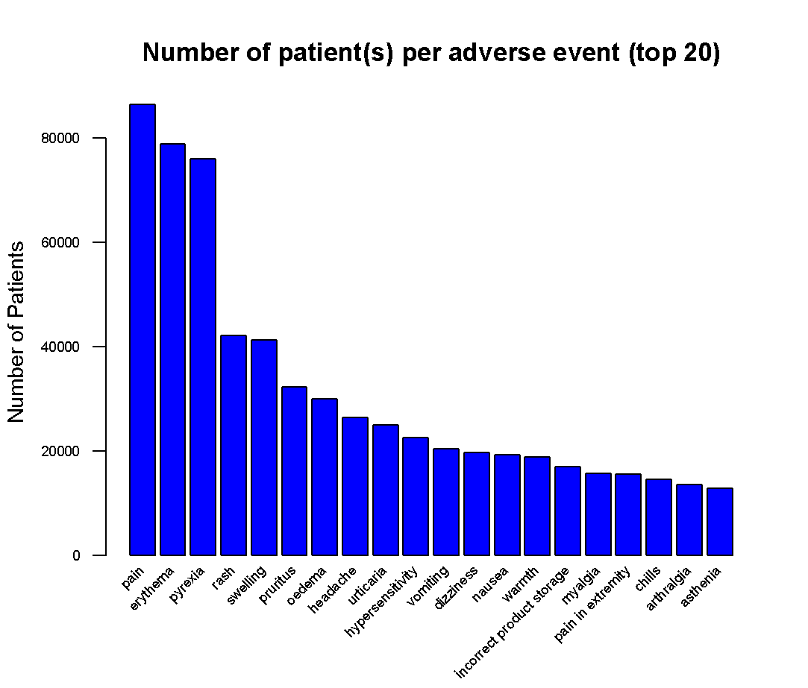
Vaccine Adverse Event Reporting System (VAERS) https://vaers.hhs.gov Sponsored by CDC and FDA
25 years in 75 Excel data sheets
450, 000 reports
87 vaccines type, n. repeats
7,900 adverse events

Slide 5
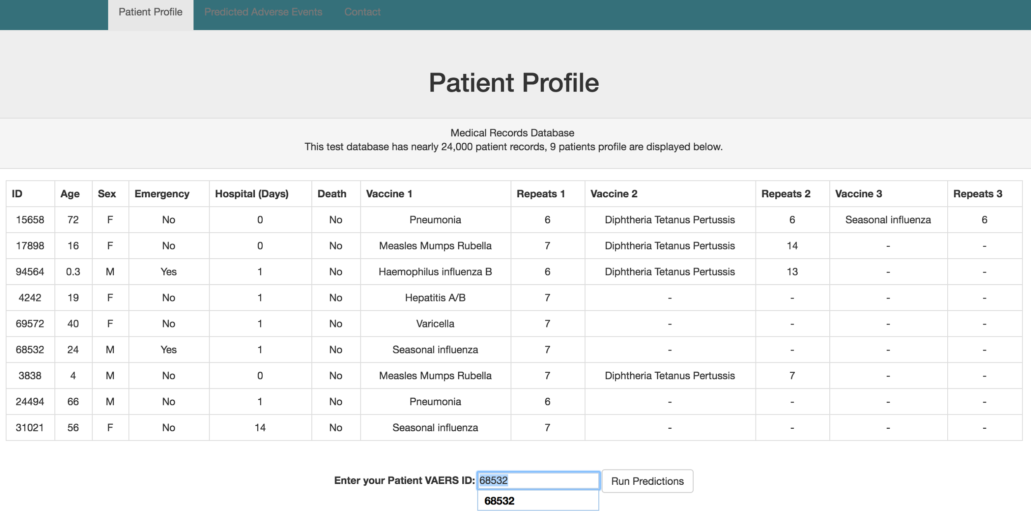

Slide 6
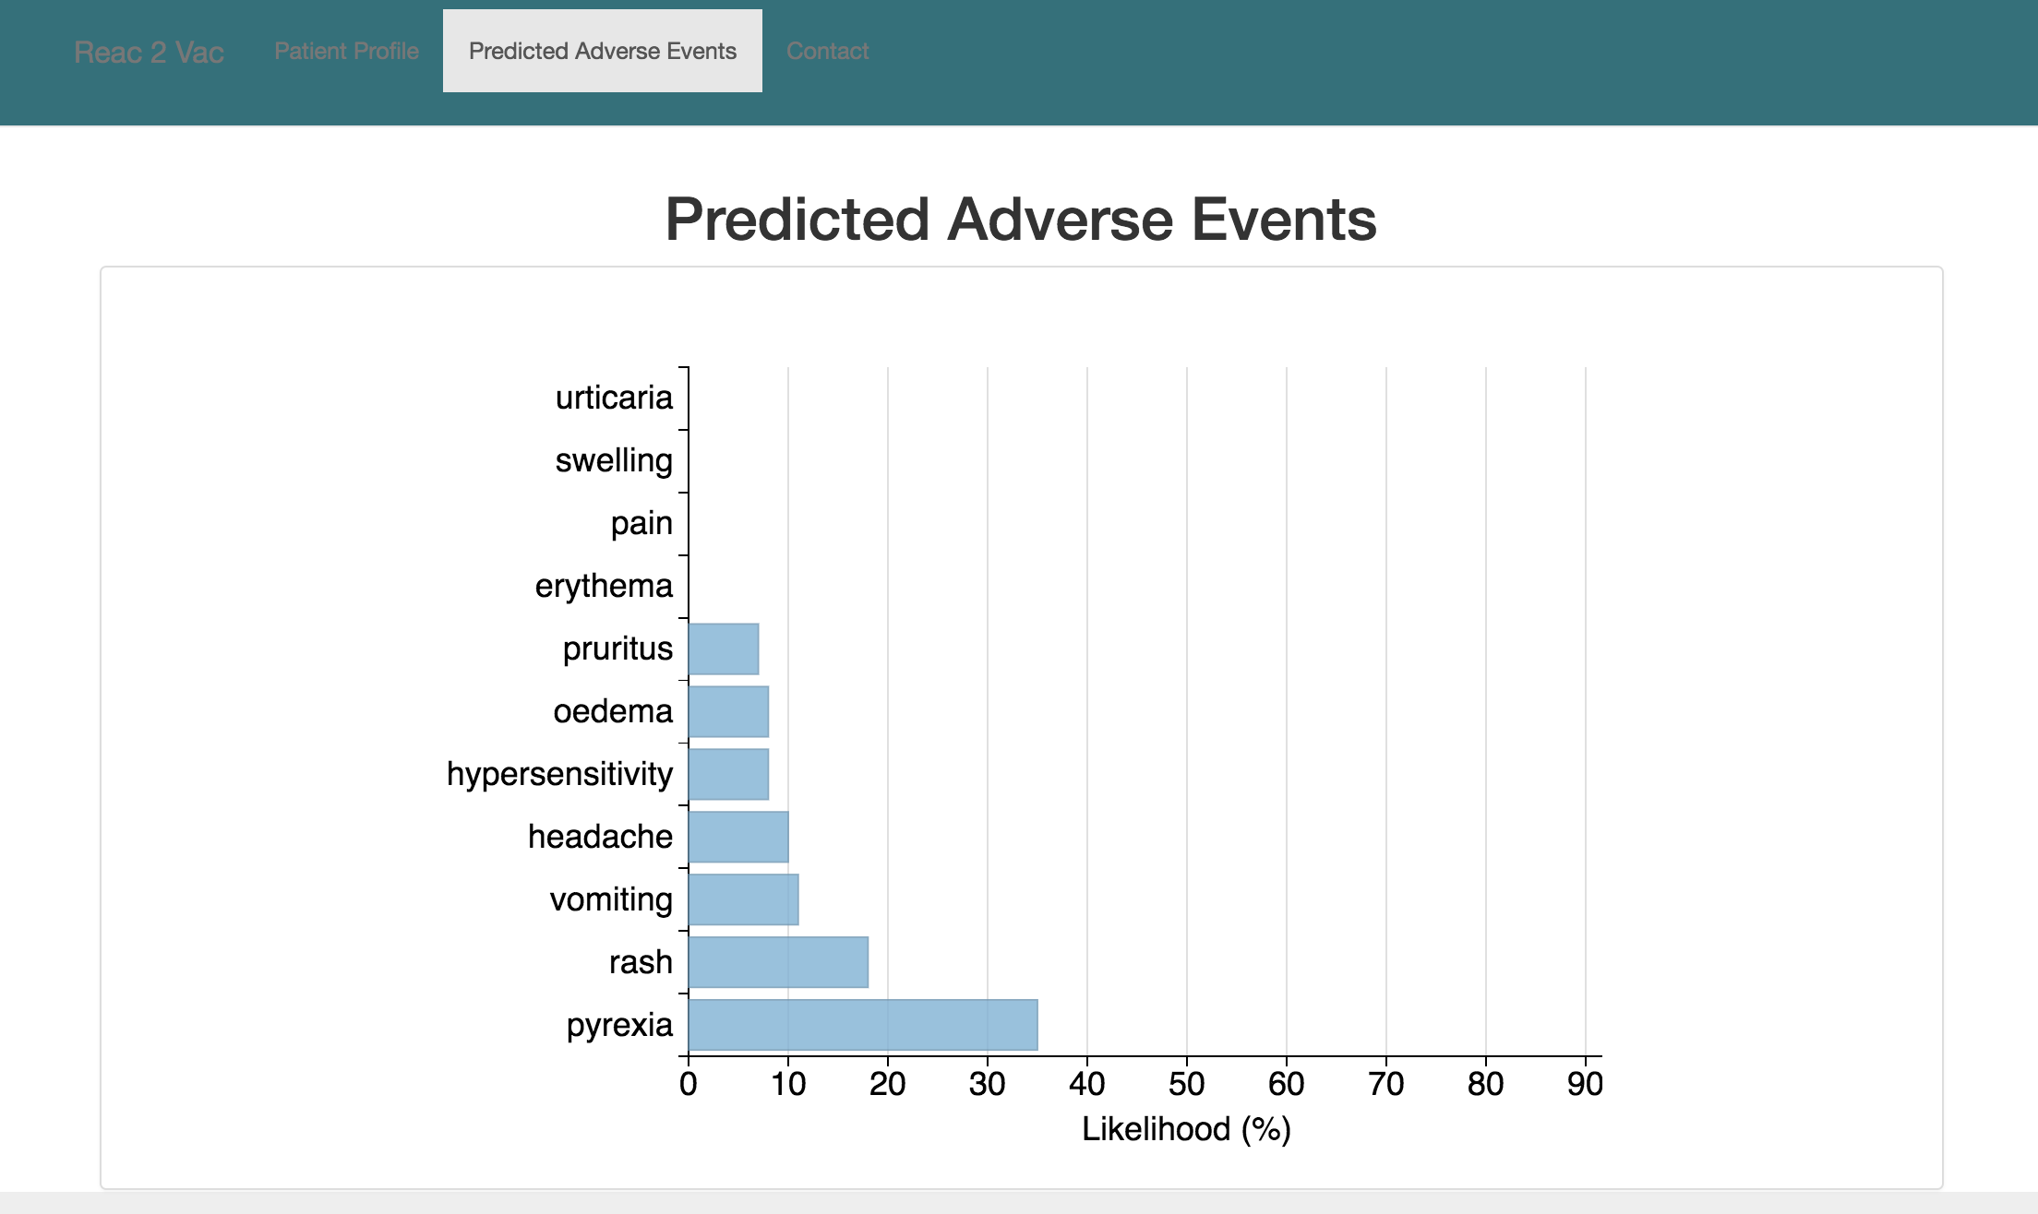

Slide 7
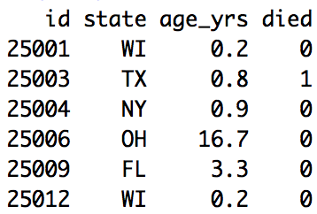
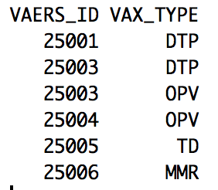
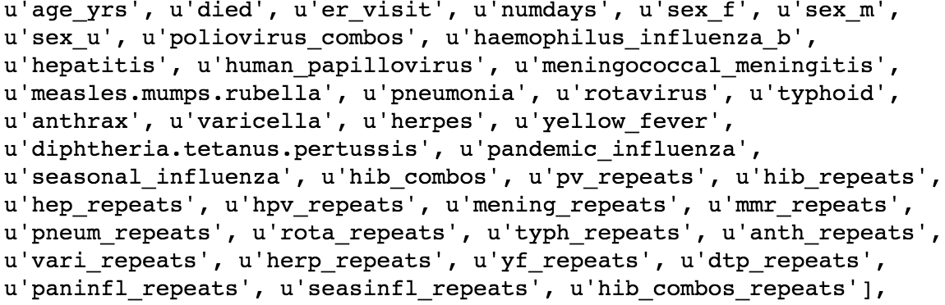
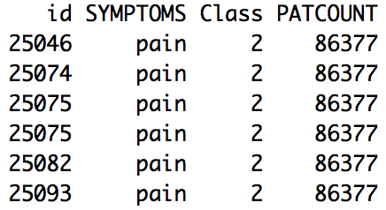
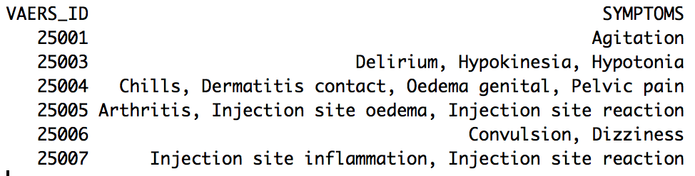
WORKFLOW
Data Cleaning, Natural Language Processing, Regular Expression
Profile
Immunization
Features
+
NLP
Classes
Likelihood
Adverse Event
Adverse Events
Return %
in each Class
Clustering

Slide 8
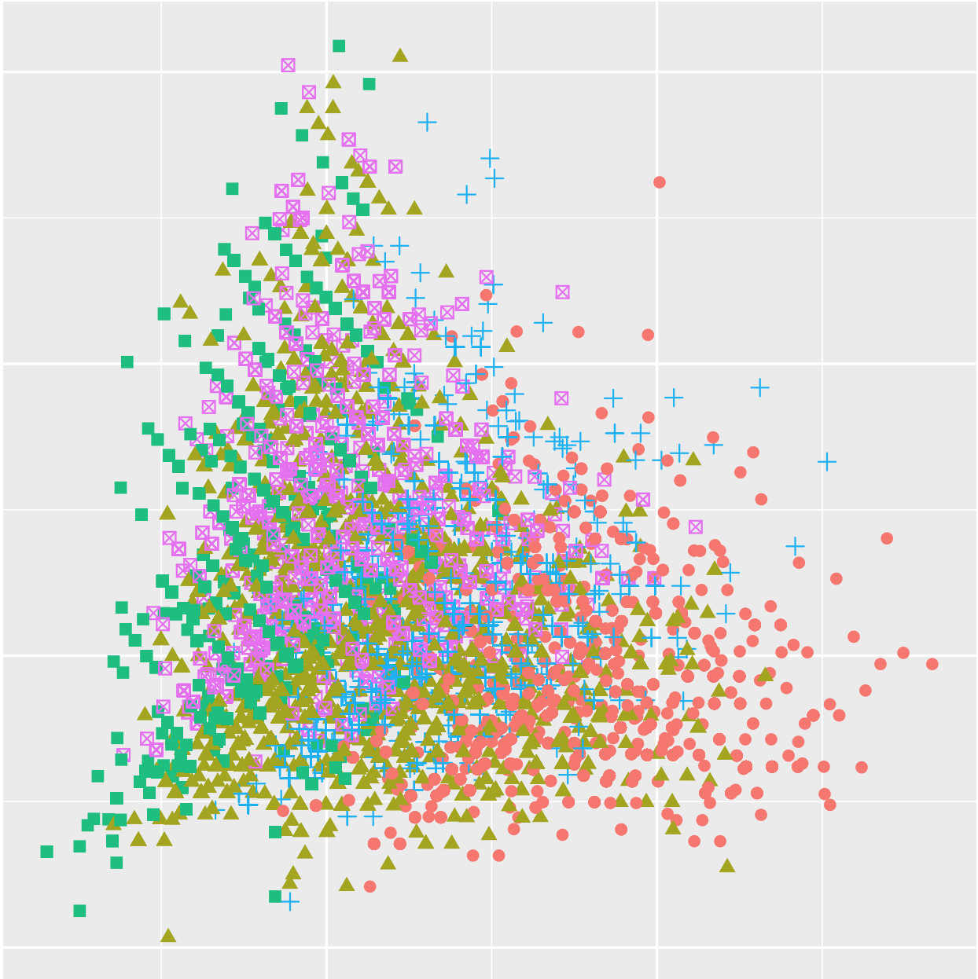
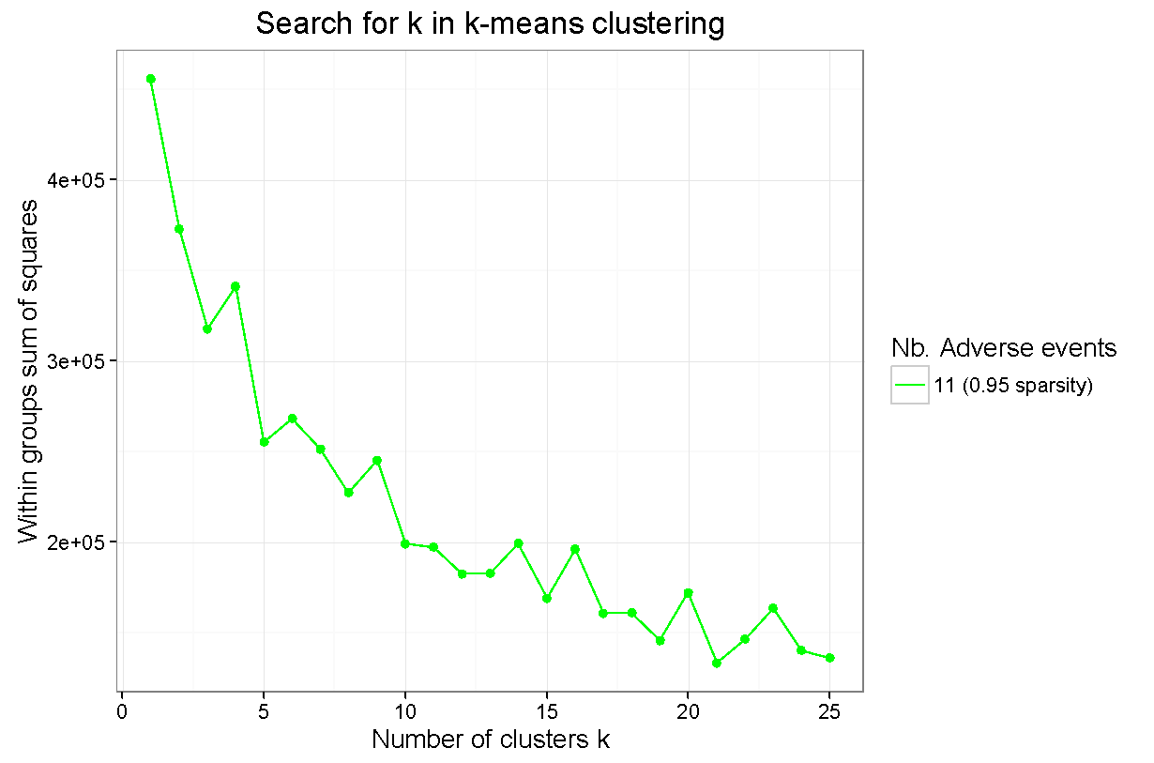
WORKFLOW
K-means Clustering Adverse Events
~390,000 patients in 11-dimension space
5 Clusters
Finding k: Elbow method

Slide 9
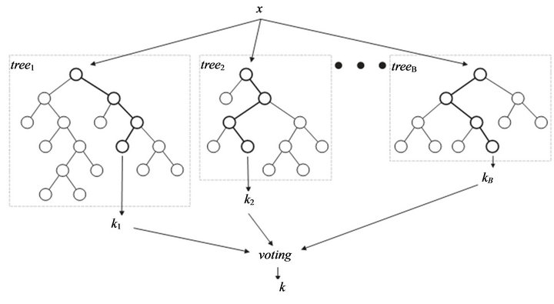
THE ALGORITHM
A Multiclass Solution
Random Forest
Why?
A multiclass classifier
Many Boolean values
Runs efficiently large datasets
How?
Imbalanced classes
Feature Selection (Recursive Feature Extraction)
Tuning: number of trees, depth
5-fold cross validation
Model | Test Accuracy (%)
Logistic Regression | 29.4
K Nearest Neighbors | 33.1
Naïve Bayes | 21.7
Decision Tree (CART) | 39.5
Random Forest | 40.1

Slide 10







ABOUT ME
PhD Organic Chemistry
University of Queensland, Australia
10 Years Research in Drug Discovery
US
Australia
Spain
France

Slide 11
